Slide 1

PREDICTIVE CUSTOMER BUYING BEHAVIOUR

Slide 2
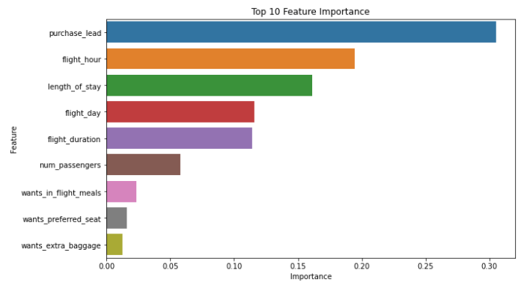
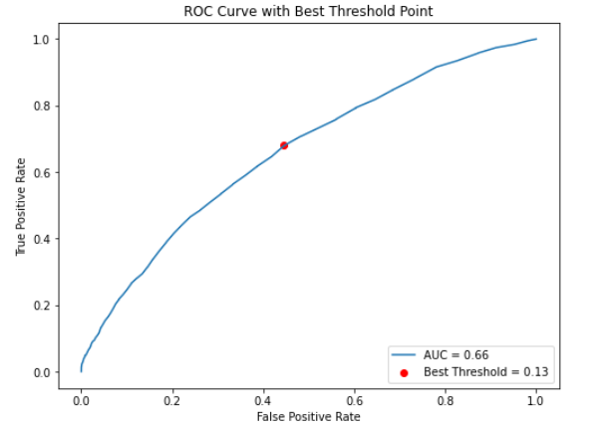
Accuracy 85 %
PREDICTIVE CUSTOMER BUYING BEHAVIOUR
We have trained the data set with Random Forest Classifier model and received
AUC Score 0,66
The features which influence Customer buying behavior are:
1) Purchase Lead, 2) Flight Hour. 3) Length of Dat, 4) Flight Day, 5) Flight Duration, 6) Number of Passengers, 7) Flight Meals, 8) Preferred Seat and 9) Extra baggage

